Slide 1
Guide to Networking Essentials,
6th Edition
Chapter 2: Network Hardware Essentials

Slide 2
Objectives
Describe the basic operation of network repeaters and hubs
Explain the purpose of network switches
Summarize the operation of wireless access points
Describe the basic operation of network interface cards
Explain the function of routers
Copyright © 2012 Cengage Learning. All rights reserved.

Slide 3
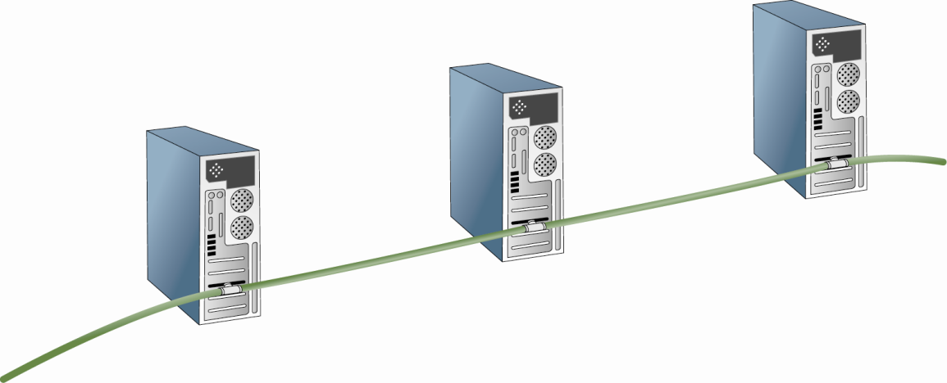
Network Repeaters and Hubs
Early networks didn’t use interconnecting devices
Severely limited the total cable length and number of computers
Copyright © 2012 Cengage Learning. All rights reserved.

Slide 4
Network Repeaters and Hubs
Some problems were resolved with a device called a repeater
  A repeater receives bit signals generated by NICs and other devices, strengthens them, and then “repeats” them to other parts of the network
A repeater enables you to connect computers whose distance from one another would make communication impossible
A traditional repeater has two ports or connections that you can use to extend your network
Copyright © 2012 Cengage Learning. All rights reserved.

Slide 5
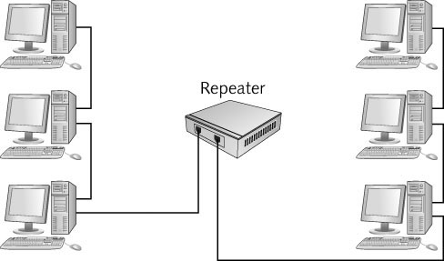
Network Repeaters and Hubs
A repeater extends the length of a network
Copyright © 2012 Cengage Learning. All rights reserved.

Slide 6
Multiport Repeaters and Hubs
A multiport repeater is just a repeater with several ports to which you can connect cabling
Also referred to as a hub
Receives bit signals generated from a connected computer on one of its ports
Cleans the signal by filtering out electrical noise
Regenerates the signal to full strength
Transmits the regenerated signal to all other ports a computer (or other network device) is connected to
Copyright © 2012 Cengage Learning. All rights reserved.

Slide 7
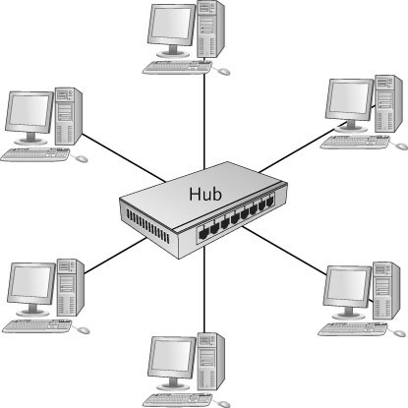
Multiport Repeaters and Hubs
A multiport repeater or hub
Copyright © 2012 Cengage Learning. All rights reserved.

Slide 8
Hubs and Network Bandwidth
Amount of data that can be transferred in an interval is network bandwidth
  Network bandwidth is usually measured in bits per second (bps) and networks operate at speeds from 10 million bps up to 10 gigabit per second (Gbps)
Hubs share bandwidth with all other connected computers
  Only one computer can successfully transmit data at a time
  Creates a problem on today’s networks due to an increased dependency on file sharing and the Internet
Bandwidth sharing – when all computers connected to the hub must share the amount of bandwidth the hub provides
Copyright © 2012 Cengage Learning. All rights reserved.

Slide 9
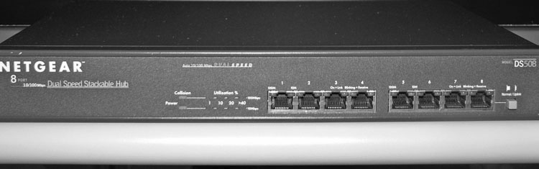
Hub Indicator Lights
Power, link status, network activity, collisions
Uplink port – port used to connect two hubs together or hub to a switch
Simulation 3: Basic operation of a hub
Copyright © 2012 Cengage Learning. All rights reserved.

Slide 10
Network Switches
Looks just like a hub
Instead of simply regenerating incoming bit signals a switch, actually reads data in the message, determines which port the destination device is connected to, and forwards the message to only that port
Basic Switch Operation
  Data is sent onto the medium one frame at a time
  The beginning of each frame has the destination MAC address
  Switch reads the addresses:
    Keeps a record of which computer is on which port (switching table)
    Forwards the frame to the port where the destination MAC can be found
Copyright © 2012 Cengage Learning. All rights reserved.

Slide 11
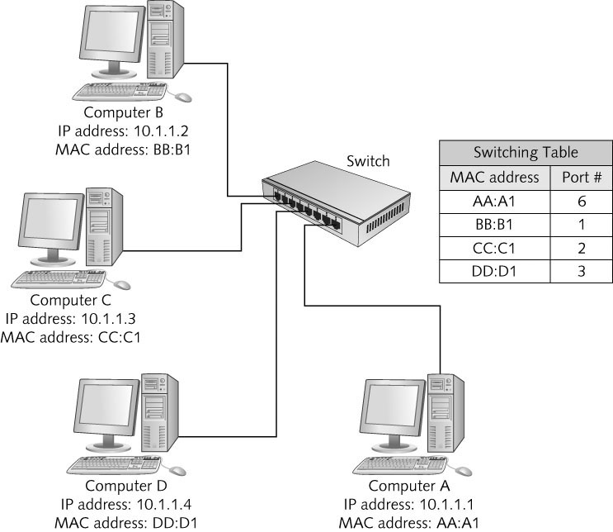
Network Switches
Switches maintain a switching table
Copyright © 2012 Cengage Learning. All rights reserved.

Slide 12
Network Switches
Steps of switch operation:
  1. The switch receives a frame.
  2. The switch reads the source and destination MAC addresses.
  3. The switch looks up the destination MAC address in its switching table.
  4. The switch forwards the frame to the port where the computer owning the MAC address is found.
  5. The switching table is updated with the source MAC address and port information.
Simulation 4: Basic operation of a switch
Copyright © 2012 Cengage Learning. All rights reserved.

Slide 13
Switches and Network Bandwidth
Each port gets dedicated bandwidth
  Instead of having to share bandwidth with all ports
Many conversations can occur simultaneously
Can operate in full-duplex mode
  Can send and receive data simultaneously
Hubs can only operate in half-duplex mode
  Can send or receive (but not both) at one time
Switches are the preferred device because of these advantages
Copyright © 2012 Cengage Learning. All rights reserved.

Slide 14
Switch Indicator Lights
Like hubs, switches have indicator lights
Switches have link status indicators and activity indicators
May also have indicators for whether the switch is operating in full-duplex or half-duplex mode
Switches can be connected to one another so that your LAN can grow beyond the limitations of ports on a single switch
  Some switches have a dedicated port for uplinking to another switch
Copyright © 2012 Cengage Learning. All rights reserved.

Slide 15
Wireless Access Points
The heart of a wireless network is the wireless access point (AP)
APs operate similarly to a hub without wires
All communication passes through the AP
Most small business and home networks use a device typically called a wireless router that combines the functions of an AP, a switch, and a router
Wireless LANs usually attached to wired networks
Copyright © 2012 Cengage Learning. All rights reserved.

Slide 16
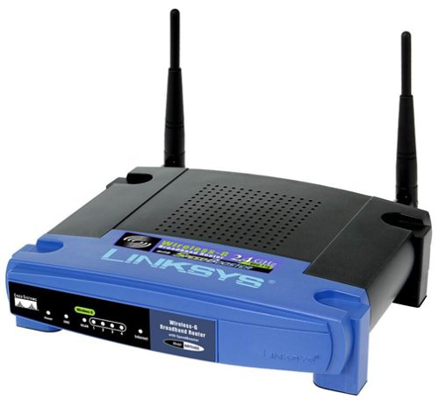
Wireless Access Points
A wireless router
Copyright © 2012 Cengage Learning. All rights reserved.

Slide 17
Basic AP Operation
Similar to a wired hub
All stations hear all data being transmitted
Extra step is required: receiving device sends an acknowledgment back to the sending device to indicate successful reception
Some configurations require additional handshaking:
  sending station must send a request to send (RTS) message and receive a clear to send (CTS) message before transmitting
  The RTS/CTS “handshake” lets all other stations know that another station is about to transmit
Copyright © 2012 Cengage Learning. All rights reserved.

Slide 18
Wireless APs and Network Bandwidth
All the extra chatter required to send data in a wireless network slows communication
The effective bandwidth is about half of effective bandwidth found on physical networks
Most APs operate from 11Mbps to several hundred Mbps
Copyright © 2012 Cengage Learning. All rights reserved.

Slide 19
Network Interface Cards
Provide a connection from computer to medium
Incoming messages: Receives bit signals and assembles them into frames
  Verifies the destination address
  Removes frame header and sends the resulting packet to the network protocol
Outgoing messages: receive packets from network protocol
  Creates frames by adding MAC addresses and error check
  Converts frame into bit signals suitable for the medium and transmits them
Copyright © 2012 Cengage Learning. All rights reserved.

Slide 20
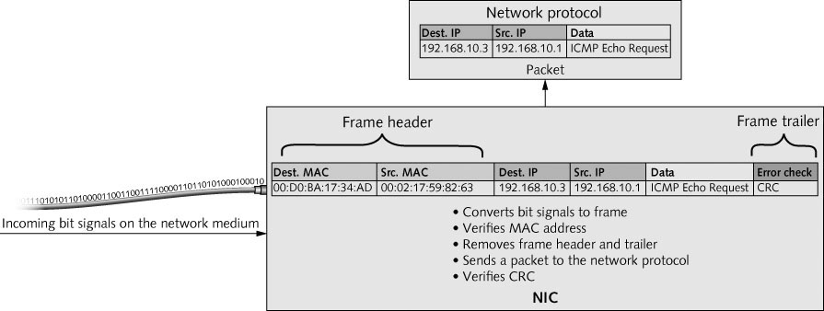
Network Interface Cards
A NIC handles incoming data from the network medium
Copyright © 2012 Cengage Learning. All rights reserved.

Slide 21
Network Interface Cards
Attaching a computer to a network requires a network interface card (NIC) to create and mediate the connection between a computer and the networking medium
  Networking medium might be copper wire, fiber-optic cable, or airwaves
Most NICs are built into a computer’s motherboard
  Occasionally fail or additional NICs are needed for an application
  It is important to know how to install a new NIC
Copyright © 2012 Cengage Learning. All rights reserved.

Slide 22
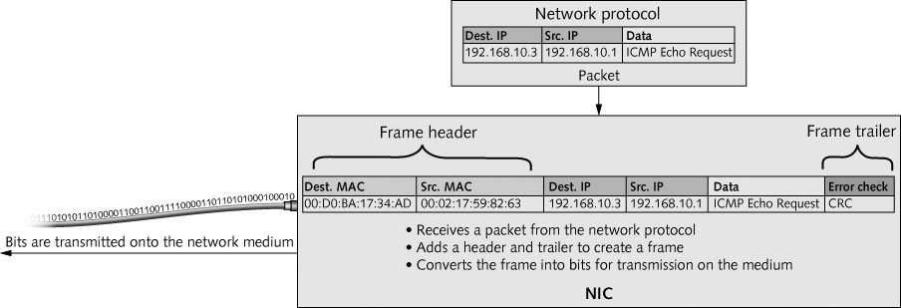
Network Interface Cards
A NIC handles outgoing data to be sent to the network medium
Copyright © 2012 Cengage Learning. All rights reserved.

Slide 23
NICs and MAC addresses
NIC manufacturers ensure that every NIC they produce has a unique address because networks won’t function correctly if duplicate MAC addresses exist
MAC address is stored in read-only memory (ROM) on the NIC
Also called the burned-in address (BIA)
Two 24-bit hexadecimal numbers
  24-bit manufacturer ID called OUI
  24-bit serial number assigned by the manufacturer
48-bit address expressed in 12 hexadecimal digits:
04-40-31-5B-1A-C4
Copyright © 2012 Cengage Learning. All rights reserved.

Slide 24
The NIC as a Gatekeeper
When a frame arrives at a NIC, the NIC checks the frame’s destination MAC address to see whether it matches its built-in MAC address
NIC only permits inbound communications if the destination MAC:
  Matches the NIC’s burned-in address
  Is a broadcast address (ff-ff-ff-ff-ff-ff)
  NIC is in a special mode called promiscuous
When the destination MAC address matches the BIA of a NIC, it’s a unicast frame
Copyright © 2012 Cengage Learning. All rights reserved.

Slide 25
The NIC as a Gatekeeper
When the destination is the broadcast address, it’s a broadcast frame
  Broadcast frames are intended to be processed by all computers on the network
Promiscuous mode – turns off the gatekeeper functions and enables the NIC to process all frames it sees
Simulation 5: How a NIC works
Copyright © 2012 Cengage Learning. All rights reserved.

Slide 26
NIC Indicator Lights
NICs have indicator lights to show status information
  Usually a link status indicator and an activity indicator
The link light is usually green when the NIC has a valid connection to the network medium
Some NICs support multiple speeds
  There is usually a separate light for each speed so that you can determine at what speed the NIC is connected to the hub or switch
  In other cases the light is a different color for each speed, such as amber for 100 Mbps and green for 1000 Mbps
Copyright © 2012 Cengage Learning. All rights reserved.

Slide 27
Selecting a NIC
Average user may never have to install a NIC because they are often built into motherboard
However, an additional NIC or a faster NIC may need to be installed
When selecting a NIC you need to select correct bus interface
  The connection the NIC makes to the motherboard is the bus connection
  Peripheral Component Interconnect (PCI) are most common
The NIC driver (software) must be available for your OS
Desktop NICs versus server NICs
  For desktops, a standard NIC is good enough
  For servers, consider a NIC with onboard memory and multiple ports and performs faster
Copyright © 2012 Cengage Learning. All rights reserved.

Slide 28
NIC Drivers
Most OSs ship with drivers for wide range of NICs
Most NICs include drivers for the most common OSs
  In most cases you only need to install the NIC and restart your computer
  If the OS has a suitable driver available, it is installed automatically
After installation, Windows 7 shows your installed NIC as a Network Connection
In Windows, each connection is assigned a name as in “Local Area Connection”, “Local Area Connection 2”
  You can rename these
Copyright © 2012 Cengage Learning. All rights reserved.

Slide 29
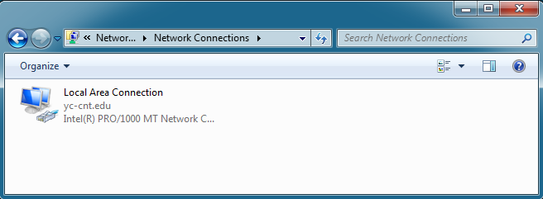
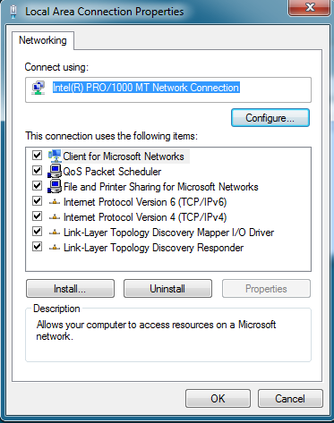
NIC Drivers
Copyright © 2012 Cengage Learning. All rights reserved.

Slide 30
Wireless NICs
Wireless NICs must be chosen according to type of wireless AP being used
Typical ones are Wireless-g, Wireless-n or 802.11 b/g
  The letter g, n, and b refer to the wireless networking standard the device supports
Wireless NICs connect to network using service set identifier (SSID)
  SSID is the name assigned to the wireless network
You may also need to enter a security key or a username and password, depending on the network’s security configuration
Copyright © 2012 Cengage Learning. All rights reserved.

Slide 31
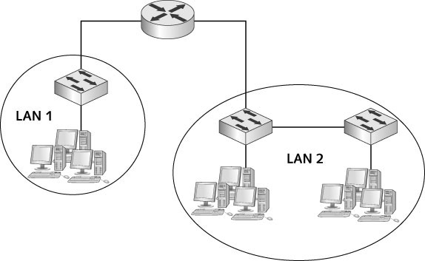
Routers
Most complex device
Connect LANs together to create an internetwork
Copyright © 2012 Cengage Learning. All rights reserved.

Slide 32
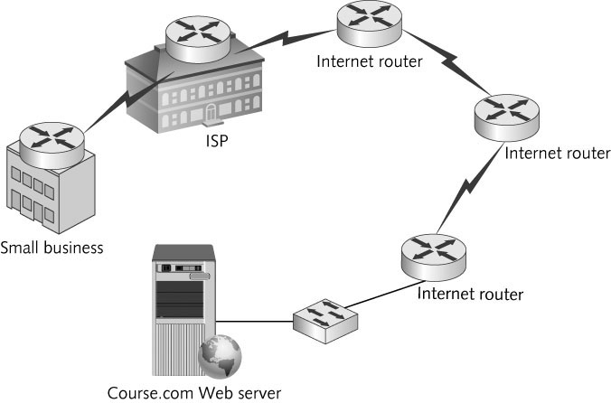
Routers
Routers are devices that enable multiple LANs to communicate with one another by forwarding packets from one LAN to another
Copyright © 2012 Cengage Learning. All rights reserved.

Slide 33
Routers
The following are the differences between routers and switches
  Routers connect LANs; switches connect computers
  Routers work with logical (IP) addresses’ switches work with physical (MAC) addresses
  Routers work with packets; switches with frames
  Routers don’t forward broadcasts; switches do
  Routers use routing tables; switches use switching tables
Copyright © 2012 Cengage Learning. All rights reserved.

Slide 34
Routers Connect LANs
As computers are added to a LAN, effective communication can suffer
  Broadcast traffic is forwarded to all members of a LAN and can cause a network to become congested
The picture on the next slide shows 3 different groups of users and 3 different servers all connected by switches
  Since they are connected by switches, they are all part of the same LAN and all broadcast traffic will be heard by all devices
Copyright © 2012 Cengage Learning. All rights reserved.

Slide 35
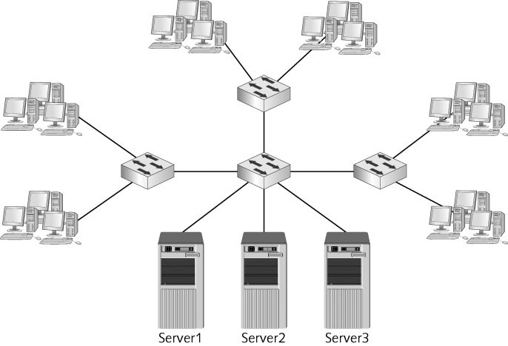
Routers Connect LANs
Copyright © 2012 Cengage Learning. All rights reserved.

Slide 36
Routers Connect LANs
The picture on the next slide shows a better solution for the previous network
The administrator groups users and servers together based on their department or function
  The router is used to create 3 separate LANs in order to contain broadcast traffic and facilitate more effective communication in each department LAN
Copyright © 2012 Cengage Learning. All rights reserved.

Slide 37
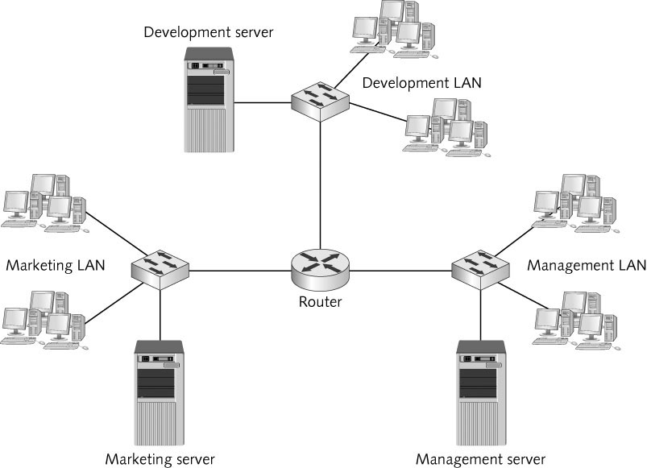
Routers Connect LANs
Copyright © 2012 Cengage Learning. All rights reserved.

Slide 38
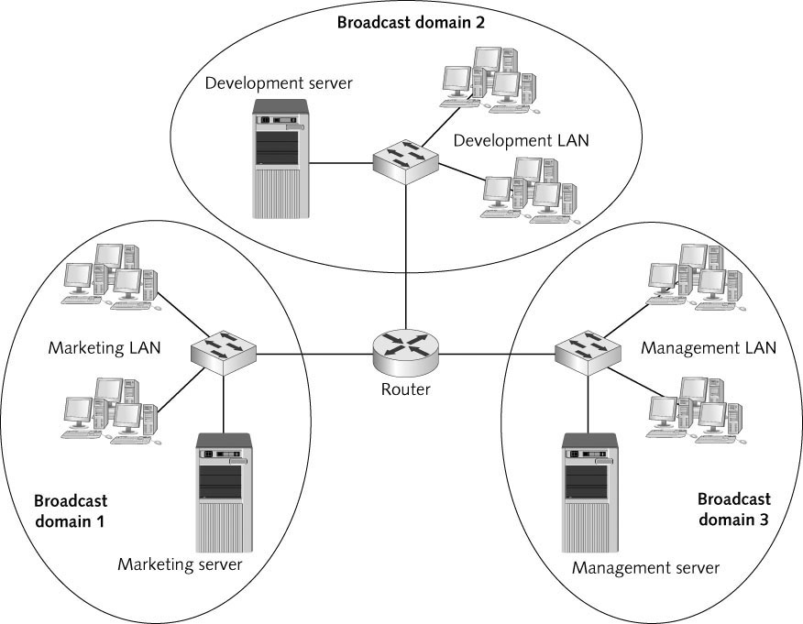
Routers Create Broadcast Domains
The scope of devices to which broadcast frames are forwarded is called a broadcast domain
  Each router interface in a network creates another broadcast domain
Copyright © 2012 Cengage Learning. All rights reserved.

Slide 39
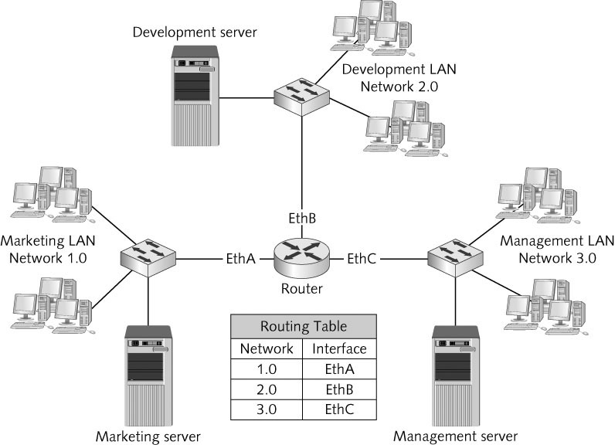
Routers Work with IP Addresses and Routing Tables
Routers maintain routing tables composed of IP network addresses and interface pairs to determine where to forward packets on an internetwork
Copyright © 2012 Cengage Learning. All rights reserved.

Slide 40
Routers Work with IP Addresses and Routing Tables
What happens when a router isn’t connected to the network the packet is addressed to?
The picture on the following slide shows what the routing table would look like on each router between the source and destination networks
Copyright © 2012 Cengage Learning. All rights reserved.

Slide 41
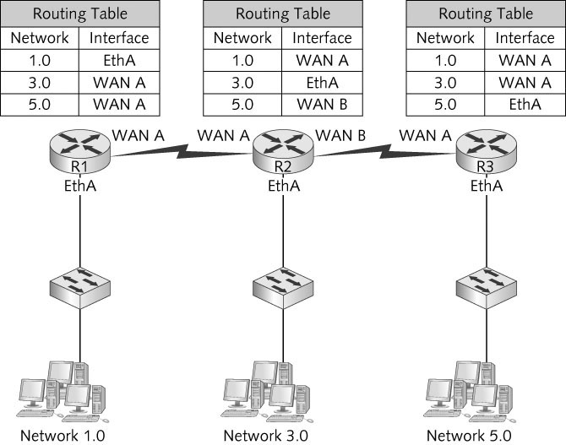
Routers Work with IP Addresses and Routing Tables
Copyright © 2012 Cengage Learning. All rights reserved.

Slide 42
Routers Work with IP Addresses and Routing Tables
Default route — where to send a packet when the router doesn’t have an entry in its routing table
Network unreachable — Message sent when the network can’t be found and there is no default route
Default gateway — In a computer’s IP address configuration – the IP address of the computer’s router
Simulation 6: Router operation in a simple internetwork
Copyright © 2012 Cengage Learning. All rights reserved.

Slide 43
Chapter Summary
Network repeaters and hubs take incoming bit signals and repeat those signals at their original strength out all connected ports
Network switches interconnect multiple computers just as hubs do
Switches use switching tables to determine which MAC address can be found on which port
Access points are a central device in a wireless network and perform a similar function to hubs
Network interface cards create and mediate the connection between the computer and network medium
Copyright © 2012 Cengage Learning. All rights reserved.

Slide 44
Chapter Summary
Wireless NICs perform the same function as wired NICs
Routers connect LANs to one another and forward packets from one LAN to another according to the destination network specified by the destination IP address in the packet
Unlike hubs and switches, routers do not forward broadcast frames
Copyright © 2012 Cengage Learning. All rights reserved.

